Slide 1

Bird Strikes

Slide 2
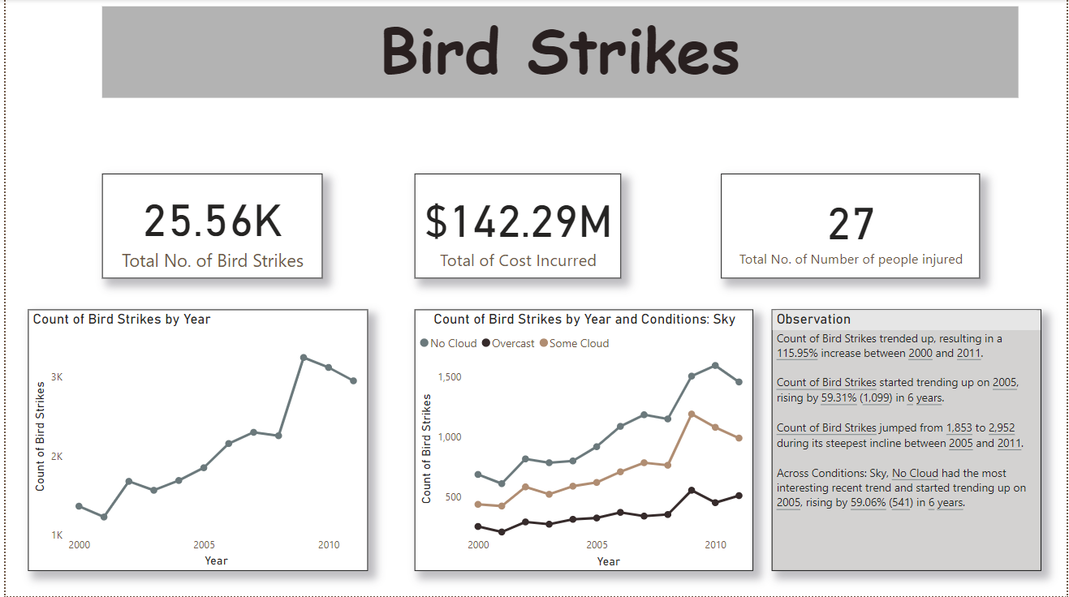
Visualization

Slide 3
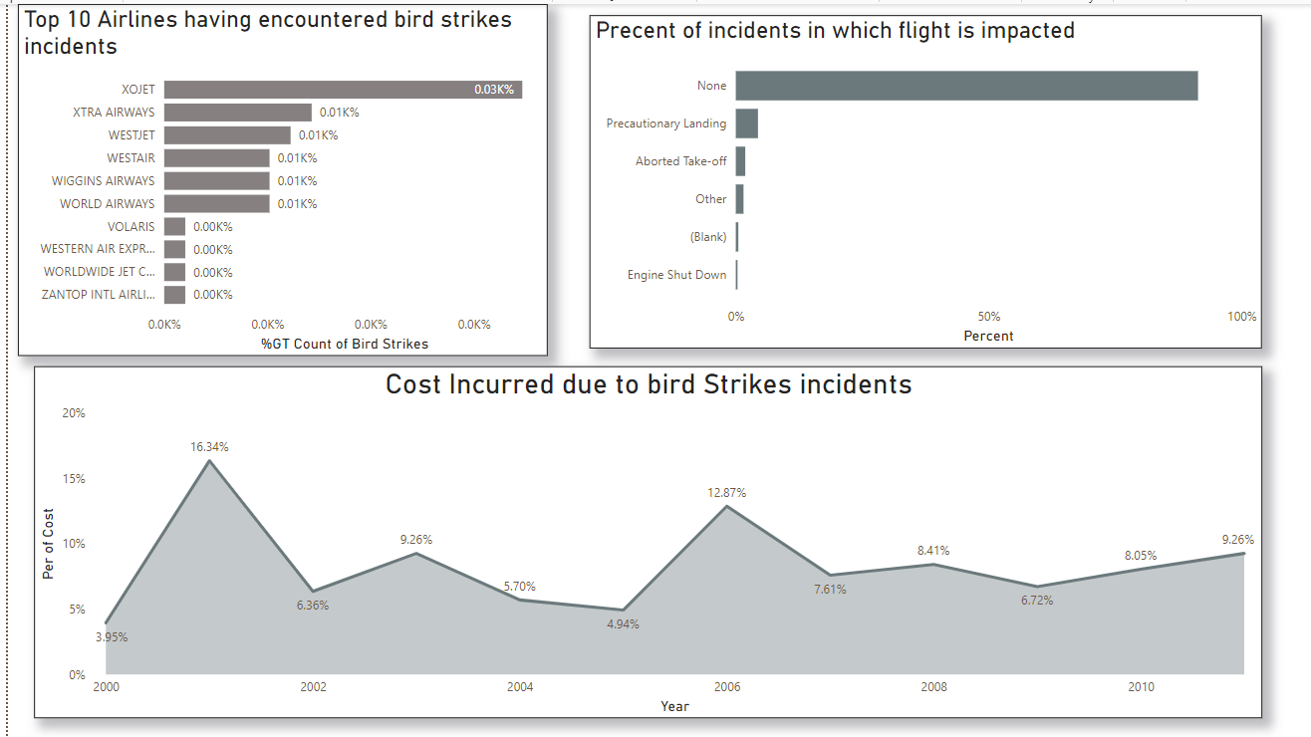

Slide 4
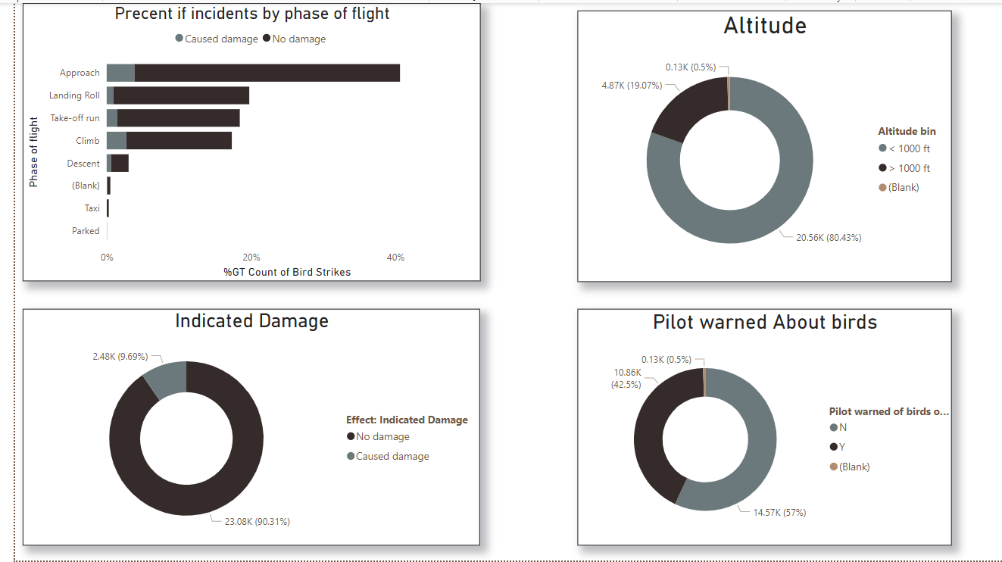

Slide 5
Thank you
Smita prajapati
prajapatismita78@gmail.com

